Slide 1
EfficientNet

Slide 2
Depth Scaling
What is Depth Scaling?
Deeper networks
Keep on increasing no of layers(depth) in network
Challenges in Deep Neural Networks:
The more deeper the network we have vanishing gradient problem.
In Resnet Vanishing gradient problem is resolved to certain extent by use of skip connections.
The more deeper the network the time taken for computation is more
In normal CNN we scale depth only(ie no of layers)

Slide 3
EfficientNet
EfficientNet is a CNN developed for image classification task by Google research team in 2020
The authors of the paper made following two observations
Scaling up any dimension of network width, depth, or resolution improves accuracy but the accuracy diminishes for bigger models (vanishing gradients).
In order to pursue better accuracy and efficiency it is critical to balance all dimensions of network Width, depth and resolution during scaling
EfficientNet consists of series of networks ranging from EfficientNet B0 – EfficientNet B7
EfficientNet B0 is considered as baseline model and acts as base for other series of network which follows the same network architecture but different scaling values in depth, width and resolution
EfficientNet is a deep neural network architecture that uses a combination of neural architecture search (NAS) and model scaling to achieve state-of-the-art performance on image recognition tasks.

Slide 4
EfficientNet
Neural Architecture Search (NAS)
NAS is a method for automatically searching for the best neural network architecture for a given task. The idea is to use machine learning algorithms to generate architectures that optimize a specific objective function.
EfficientNet uses a variant of NAS called “MBConv” (Mobile Inverted Residual Bottleneck Convolution) to generate its architecture.
Model Scaling
Model scaling involves increasing the depth, width, and resolution of the network in a principled way. EfficientNet uses a compound scaling method that scales the network’s dimensions uniformly.
The scaling factor is controlled by a single coefficient “phi“, which is optimized during the NAS process.
This approach leads to a significant improvement in performance over existing networks without increasing the computational cost.

Slide 5
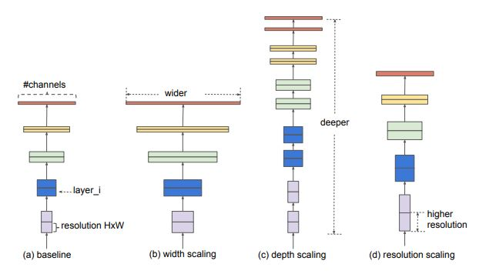
Types of scaling
In EffcientNet scaling is done on
Depth – number of layers
Width – number of channels/feature maps
Resolution – Image height and width
Resolution Scaling
Increasing the image size (height, width)
In an image more pixels means more information
If an image is bigger or is of higher resolution then there is more complex features and fine grained patterns present whereas, if the image is smaller or is of lower resolution then there is less complex features present.
Accuracy will be high for high resolution image
DPI – dots per inches
Low resolution ( 72 DPI), High resolution ( 300 DPI)

Slide 6
Types of scaling
Depth Scaling
Increasing the number of layers in neural network
High resolution image -> more information
To extract features from high resolution image more layers in the network are needed
How much depth scaling(no of layers) is required for specific input image size?
Width Scaling
Increasing number of channels / feature maps
More channels -> more features extracted
High resolution images – need more number of feature maps to extract more information
How much width scaling is required to increase the performance ?
Very high feature maps may result in increasing the computation time

Slide 7
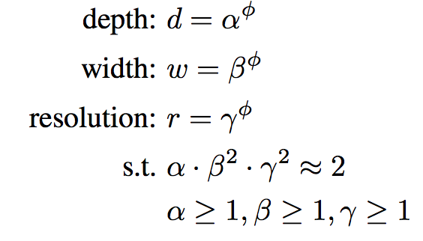
Compound Scaling
Authors used compound scaling to choose how much scaling is required for Width, Depth and Resolution
To do compound scaling we need a baseline model ‘EfficientNet B0’
Authors applied grid search techique to get the parameters alpha, beta, gamma, phi
Afterwards they fixed the sacling coefficients ans scaled efficientnetB0 to effcientnetB7
Alpha, beta, gamma -> fixed values
Phi -> Hyperparameter that can be changed

Slide 8
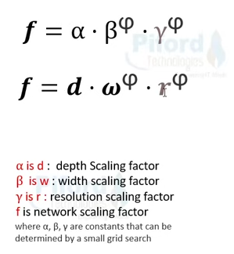
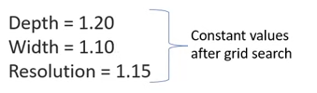
Compound Scaling
..
Grid search is applied to know the relationship between depth, width and resolution and determine the scaling coefficients accordingly.
Constant values determined by authors
Depth -> Alpha -> 1.20
Width -> Beta -> 1.10
Resolution -> Gamma -> 1.15
If resolution of image increases by 15% then depth should be increased by 20% and width should be increased by 10%.

Slide 9
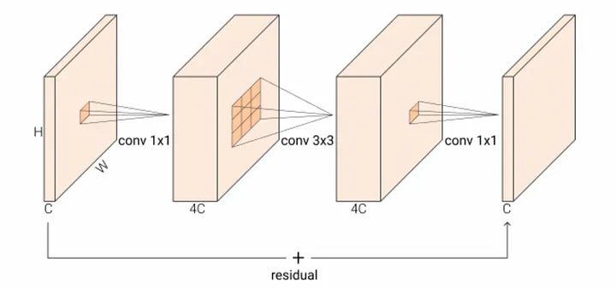
Residual Vs Inverted residual blocks
Conventionally, a 3x3 convolution operation is simply just running a kernel with (3,3) size on input with depth D1 and producing an output with depth D2.
However, for a normal residual bottleneck block, the input’s depth is reduced first through a 1x1 convolution. Then, a 3x3 convolution is applied to the reduced-depth input. Finally, the depth is re-expanded through the 1x1 convolution.
This fancy operation is called depth-wise separable convolution. Indeed, it separates the simple 3x3 convolution into the1x1 compression, 3x3 on the compressed, 1x1 expansion process.
Then, the initial and the ending feature maps are added to the network can learn more diverse features.
This fancy operation uses significantly fewer parameters and is more efficient in computation.
For an inverted residual block, the depth changing scheme is “inverted,”.
So, from
Wide → Narrow → Wide to
Narrow → Wide → Narrow.
The inverted version is proven to work better and is more memory efficient because it can now remove the non-linearities in the narrow layers to have better representation power.

Slide 10
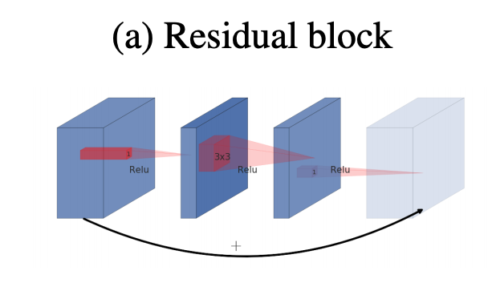
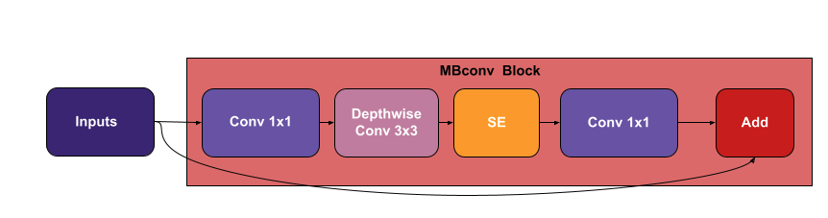
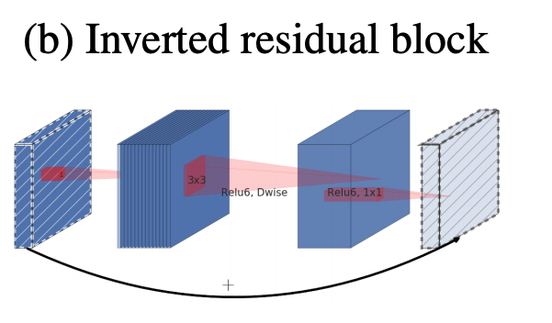
EfficientNet blocks
MBConv
MBConv is an inverted residual bottleneck block with depth-wise separable convolution.
Squeeze and Excitation (SE) Block
SE is a building block for CNNs to improve the interdependencies between the channels by performing dynamic feature channel-wise recalibration, this means that instead of equally weighting all the channels, the network will dynamically assign high weight for the most important channels
Which channels chould be prioritized
EfficientNet applies the SE block along the way with the MBConv block

Slide 11
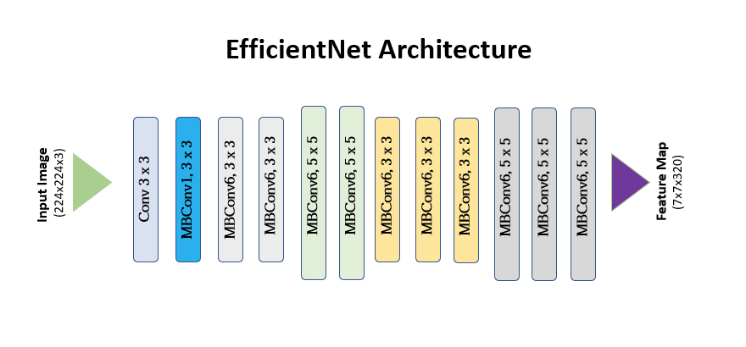
EfficientNet architecture

Slide 12
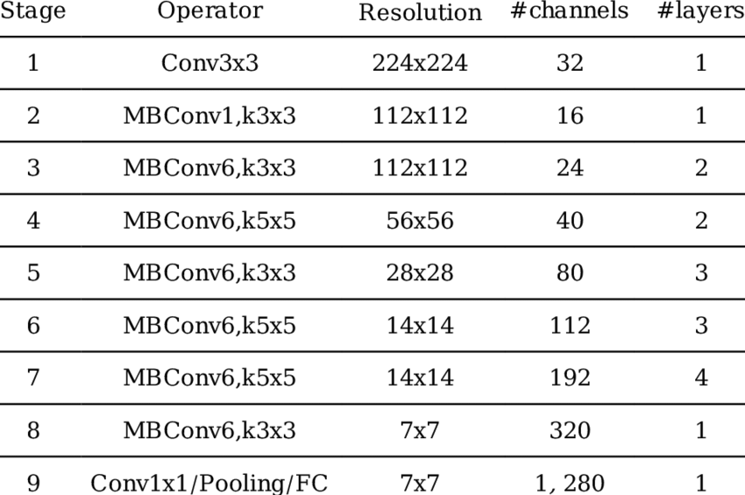
EfficientNet-B0
Knowing d, w, and r, EfficientNet-B0 is proposed.

Slide 13
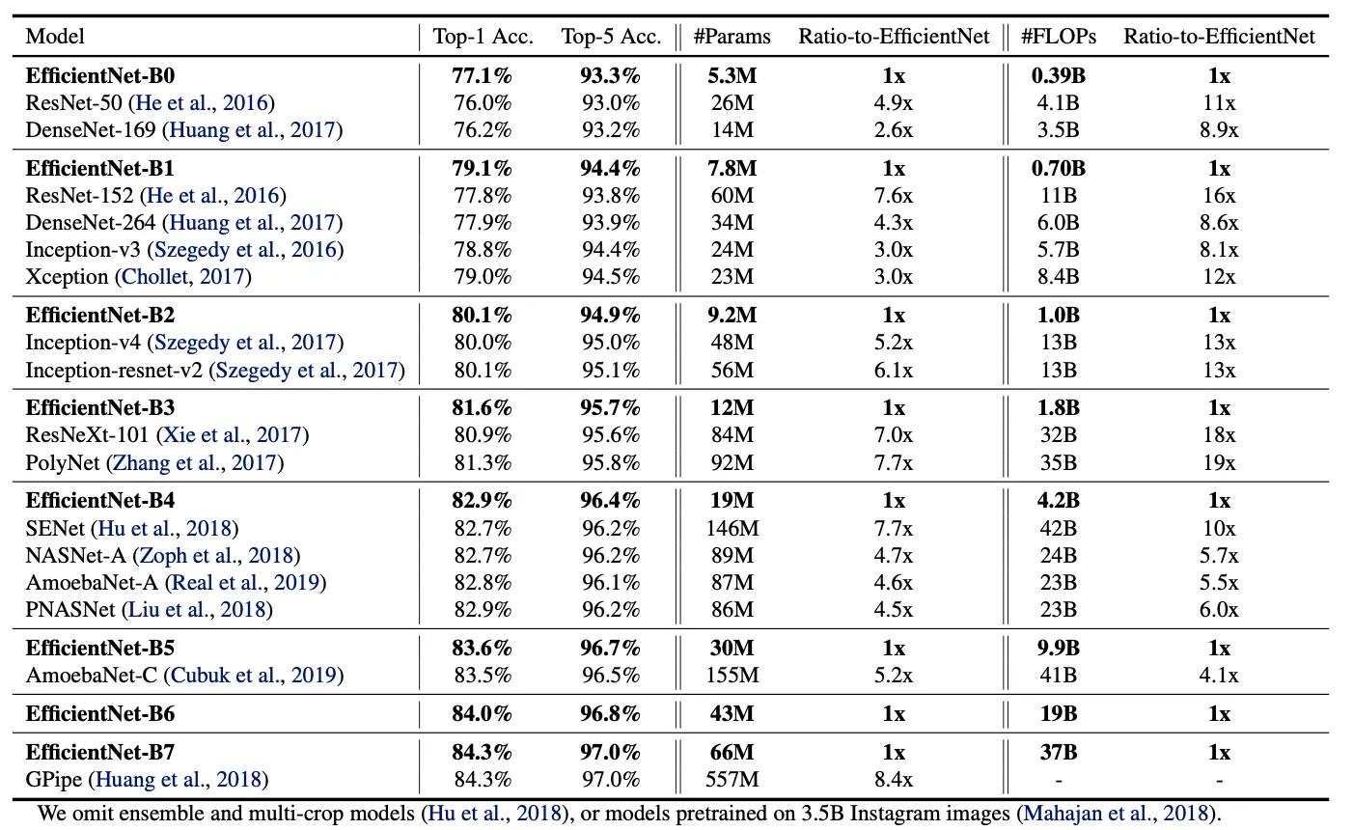
EfficientNet performances
..

Slide 14
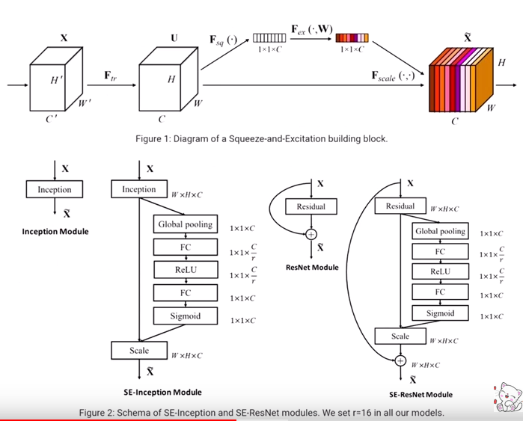
SqueezeNet in EfficientNet
..

Slide 15
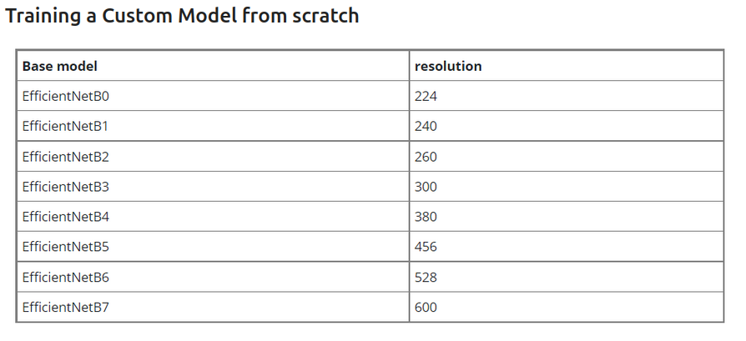
EfficientNet
..

Slide 16
EfficientNet: Rethinking Model Scaling for Convolutional Neural Networks
EfficientNet architecture
EfficientNet — An Elegant, Powerful CNN
Complete Architectural Details of all EfficientNet Models

